Slide 1
RFE ATB Quick Reference (v1.75) (documentation made for WorkPackage software)
DATE: JuL/6/2021
Michiel Hallie (IP lead)
Anindita Roy Chowdhury (IP lead)
Hemant Bhasin (Design)
Chandra Prakash (Design)

Slide 2
Introduction AC + DC ATB

Slide 3
ATB-RFE IP – modules + references
Modules
DC-ATB
connecting IPs to the ATB-IP (mainly static signals)
Use Cases decribed in e.g. Silver Design Review Document (see link @References – ATB RFE documentation)
AC-ATB
connecting RX IP / ADC(RX) IP
Use Cases decribed in e.g. Silver Design Review Document (see link @References – ATB RFE documentation)
BandGap
reference voltage (0.7V) for ADCs
AMSIP Analog Modules - Bandgap > C028BG0v9
https://nww.sharepoint.nxp.com/teams/13/Analog_Mixed_Signal_IP/Shared%20Documents/Managed%20IP/cmos028hpcp/docs/amos_c028hpcp_bg0v9_data_sheet.pdf
GP-ADC
10 bits @5MHz(max)
AMSIP Analog Modules - Data Converter > Medium Bandwidth ADC C028AD10b5M
https://nww.sharepoint.nxp.com/teams/13/Analog_Mixed_Signal_IP/Shared%20Documents/Managed%20IP/cmos028hpcp/docs/amos_c028hpcp_ad10b5m_data_sheet.pdf
References
DfT document
https://www.collabnet.nxp.com/sf/go/doc426961?nav=1&pagenum=1&pagesize=15
Register Map (RM)
https://www.collabnet.nxp.com/sf/go/doc435009?nav=1&pagenum=1&pagesize=15
ATB RFE documentation
https://www.collabnet.nxp.com/ctf/documents/list/projects.smarttrx/docman.root.es0.011_ic_architecture_design_and_i.non_fdo_documents.analog_ip_design.ams_ips.atb

Slide 4
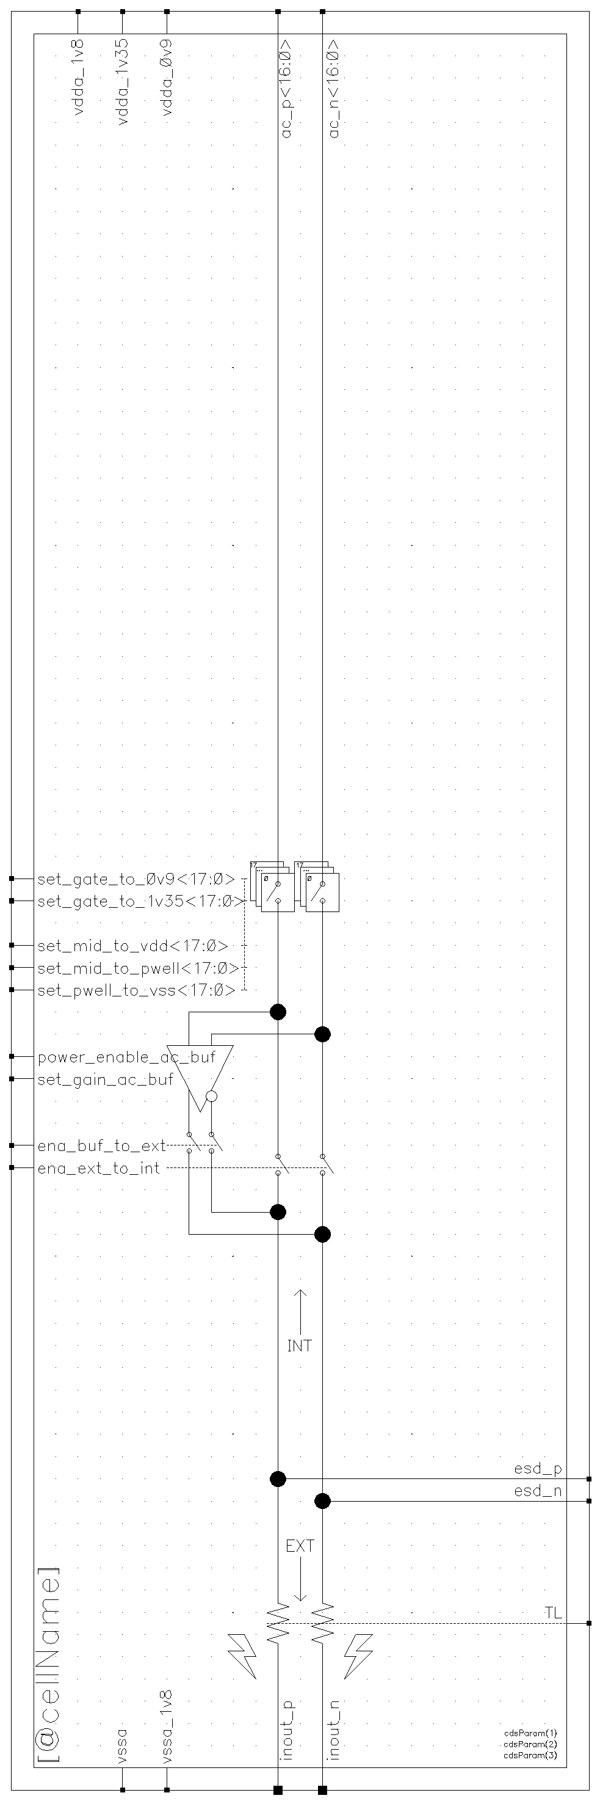
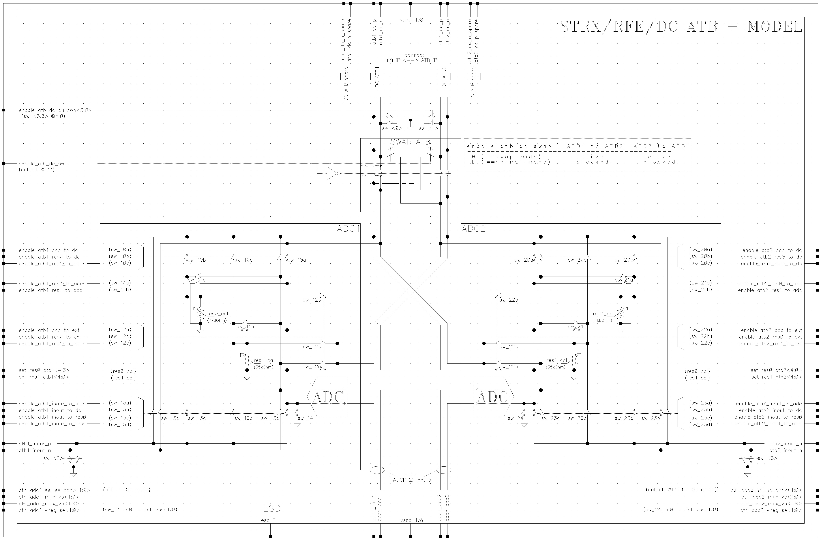
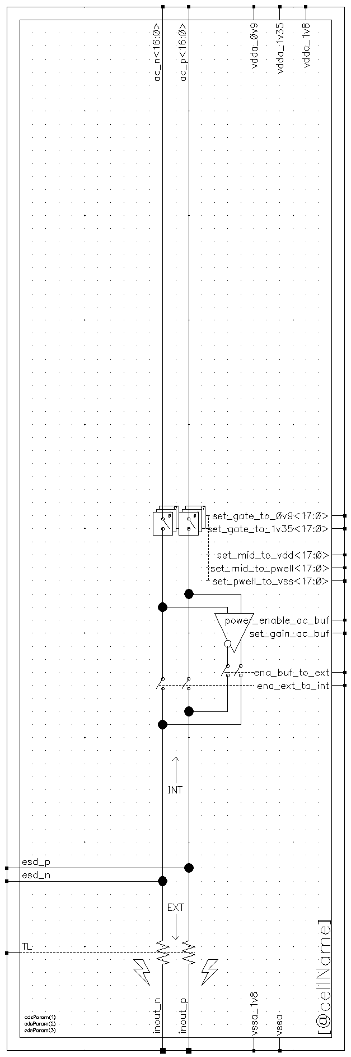
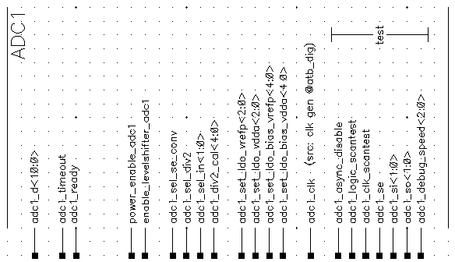
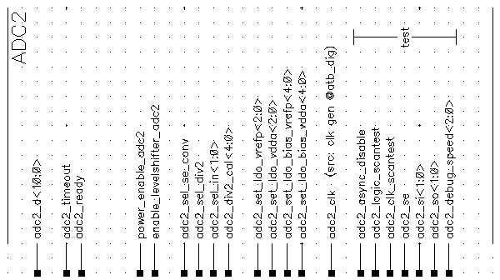
ida_mmw_rfe_atb_ana_lib/ida_mmw_rfe_atb_ana_master(_ac)
simplified view
DC ATB1
DC ATB2
AC ATB1
AC ATB2
→ ATB1_N_DEBUG
ATB2_N_DEBUG ←
→ ATB1_P_DEBUG
ATB2_P_DEBUG ←
ADC1 interface
ADC2 interface

Slide 5
DC-ATB quick reference

Slide 6
DC-ATB - connectivity matrix
destination
 | IP atb1_dc_<p,n> | IP atb2_dc_<p,n> | External (IO pin) atb1_inout_<p,n> | External (IO pin) atb2_inout_<p,n> | ADC_1 (input) | ADC_2 (input) | R_7k8 @atb_1 | R_35k @atb_1 | R_7k8 @atb_2 | R_35k @atb_2
IP atb1_dc_<p,n> | - | - | ☑ (no buffer) | ☑ f(swap) | ☑ | ☑ f(swap) | ☑ | ☑ | ☑ f(swap) | ☑ f(swap)
IP atb2_dc_<p,n> | - | - | ☑ f(swap) | ☑ (no buffer) | ☑ f(swap) | ☑ | ☑ f(swap) | ☑ f(swap) | ☑ | ☑
External (IO pin) atb1_inout_<p,n> | ☑ | ☑ | - | - | ☑ | ☑ | ☑ | ☑ | ☑ | ☑
External (IO pin) atb2_inout_<p,n> | ☑ | ☑ | - | - | ☑ | ☑ | ☑ | ☑ | ☑ | ☑
source
☑ simulated

Slide 7
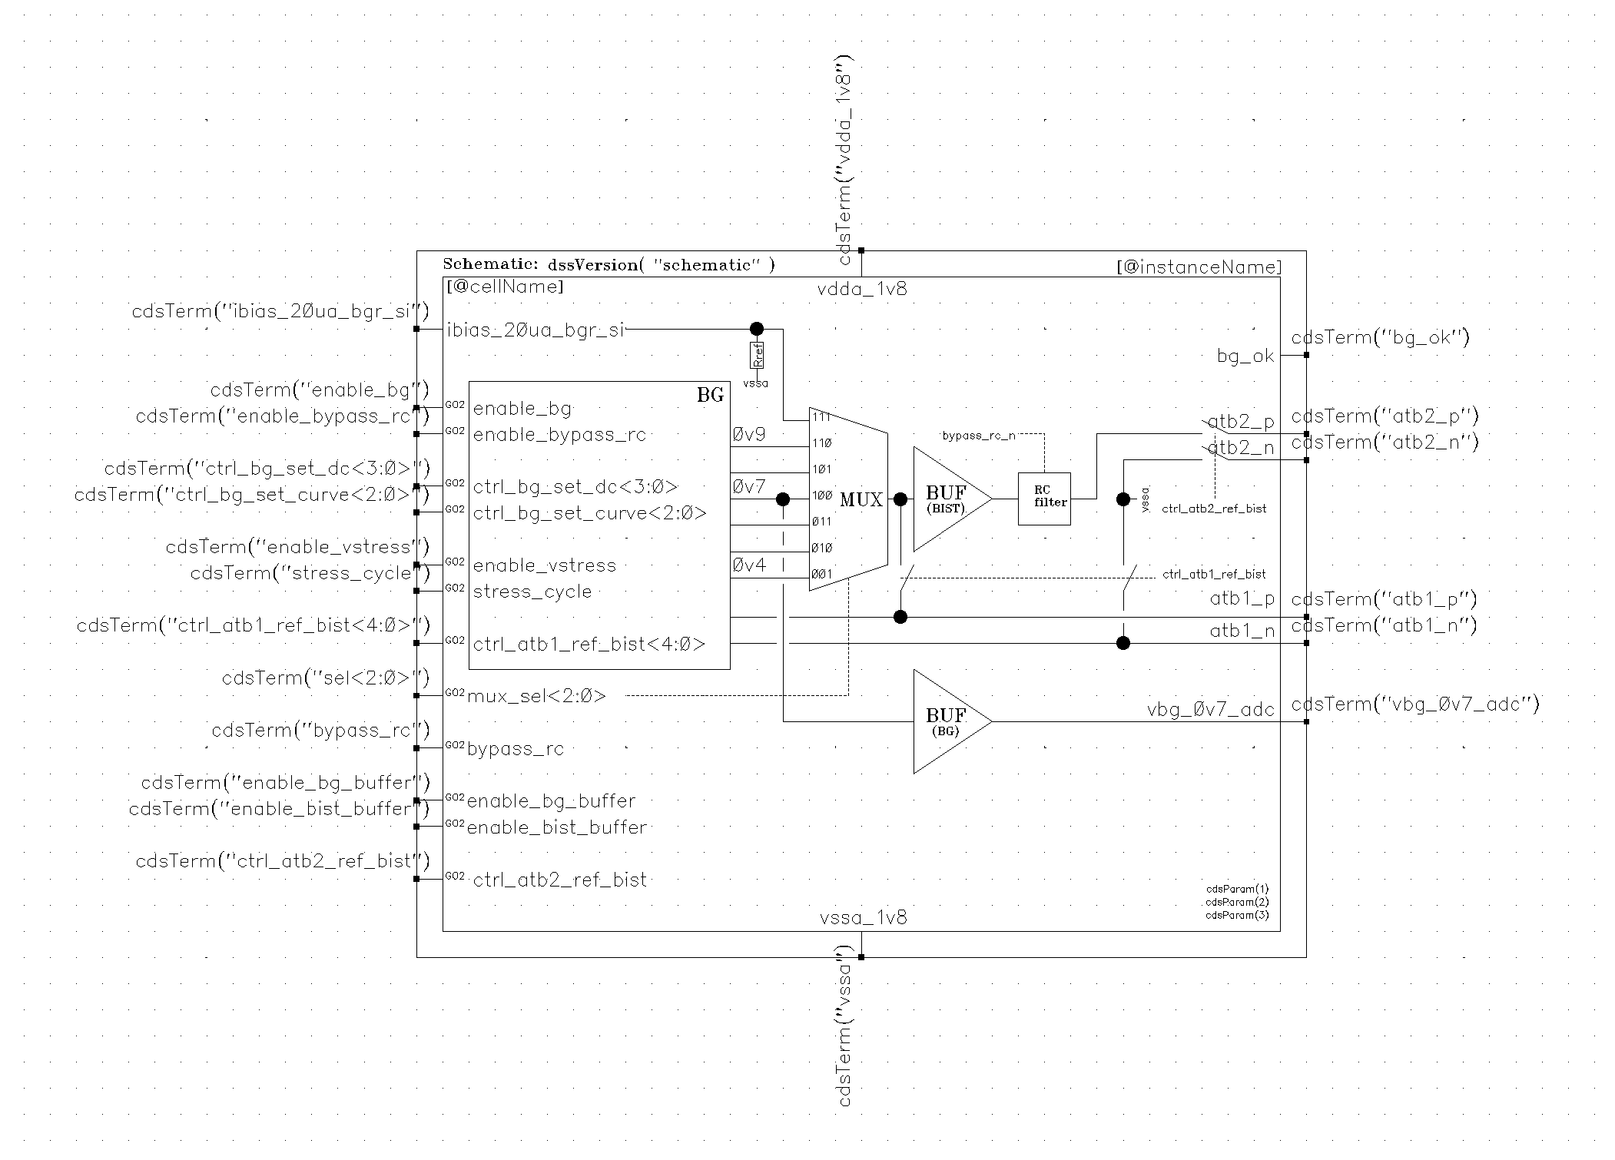
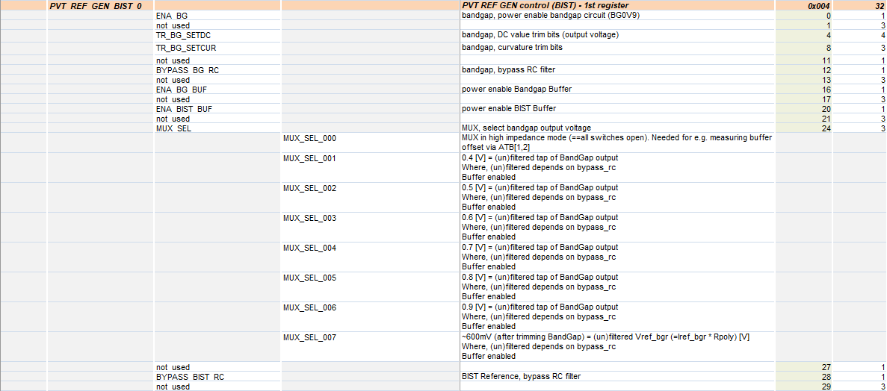
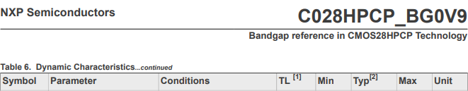
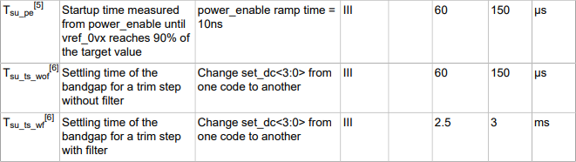
ida_mmw_rfe_atb_ana_lib/ida_mmw_rfe_atb_ana_ref
BandGap provides reference voltage (0.7V) for GP-ADCs
assuming normal operation, Vdda_1v8 present
◆
enable levelshifters
❖
Settings @BandGap
b’1
b’1
b’1
b’1
b’1001
b’100
b’1
b’1
b’0
b’0
b’0
<lib>/<cell>=ida_mmw_rfe_atb_ana_lib/
ida_mmw_rfe_atb_ana_ref
⬥
BandGap startup → status ok flag?
Bit settings needed to have DC-ATB (incl. enable level-shifters (pon_ls), Reference 0V7, buffers, etc.) in operating mode.
During BandGap startup, advise to have BYPASS_BG_RC=b’1 (==filtering off, therefore faster startup). Once up-and-running, make BYPASS_BG_RC=b’0 (== filtering enabled)
Default ATB-RFE IP is off (see also Reg. Map)
Datasheet BG0V9

Slide 8
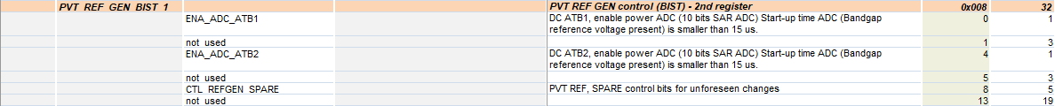
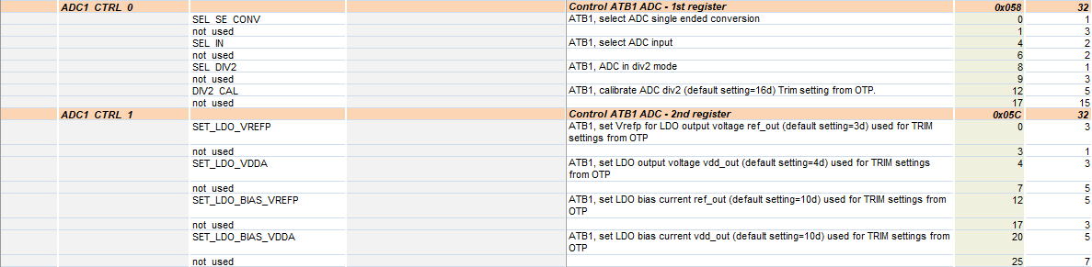
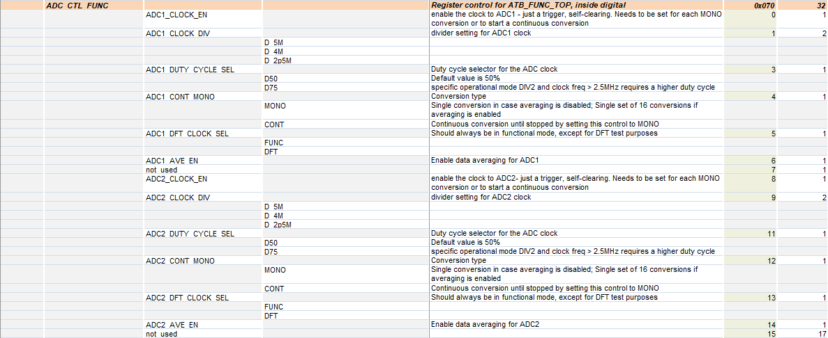
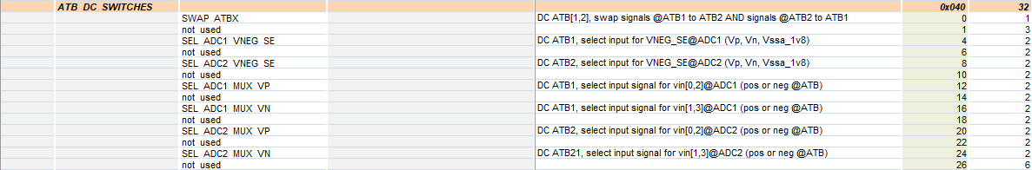
Register Map ATB-RFE – ADC (screenshot)
b’0
Settings @ADC, see datasheet
link @slide 2
b’0
can also be adc2
can also be adc2
Switch configurations for different connection
scenarios to the ADC(s)
e.g., swap signals ATB1 and ATB2 ( Reg. field SWAP_ATBX)
e.g., swap p and n @ADC input ( Reg. fields ADC[1,2]_MUX_V[P,N])
e.g., connect internal gnd to ADC @SE mode
(for specific details, see appendix (artf tickets)

Slide 9
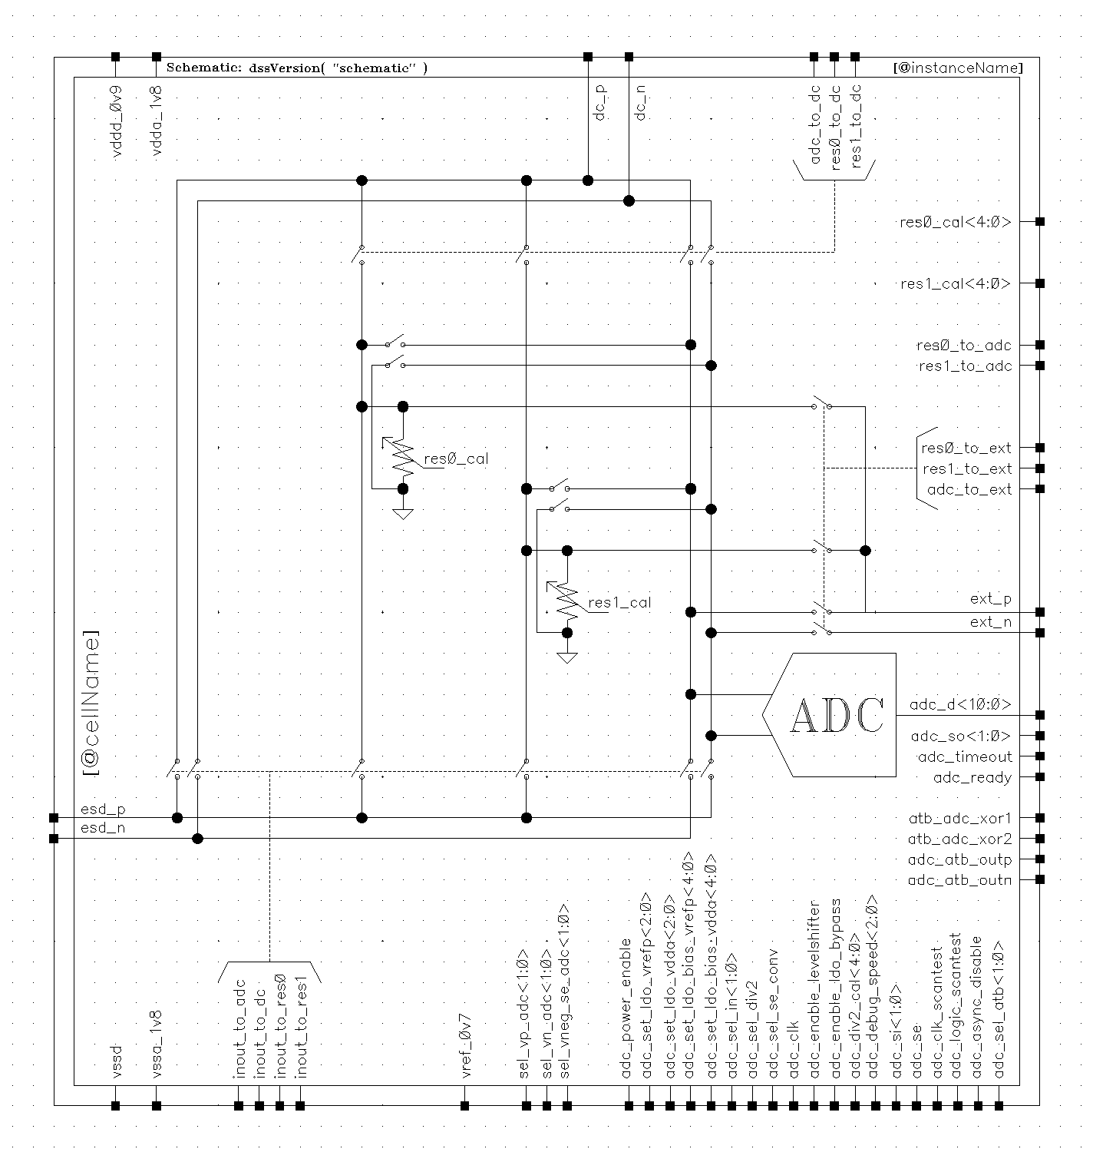
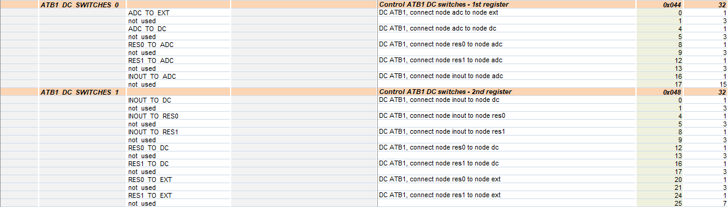
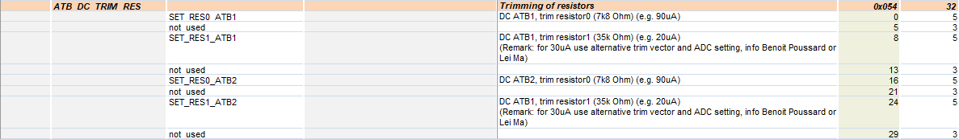


◆
Register Map ATB-RFE – DC ATB (screenshot)
DC-ATB[X,Y]
disable pulldown ATB lines
IP @ATBx
x’1FFFF
x’F
b’1
can also be atb2
can also be atb2
❖
Select the switches according to the Use_Case needed
alternative view @next slide
(inout_p)
(inout_n)
ATB[x,y]_N_DEBUG $⟻$
ATB[x,y]_P_DEBUG $⟻$
⬥
In case of current measurement, set the resistor trim values
and choose the type of measurement

Slide 10
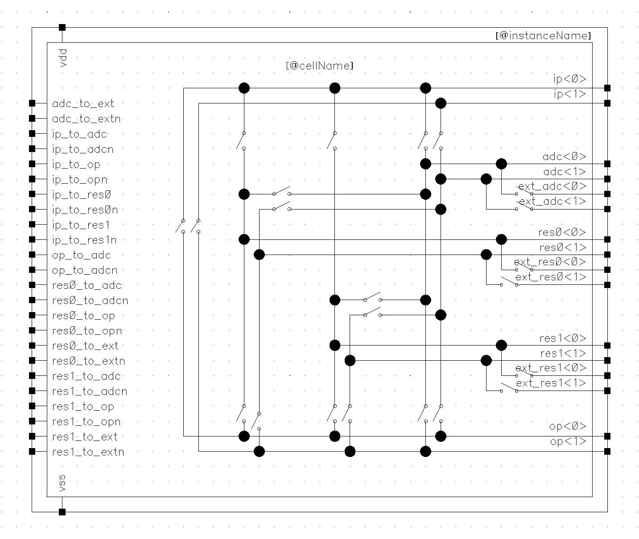
1.8V (FuSa)
DC-ATB[X,Y]
dc_p
IP @ATBx
dc_n
ADC x
Ω₀
vp_adc
101…1010
vn_adc
ext_p
ADC y
101…1010
ext_n
res0<0>
res0<1>
res0_p
35kΩ
vssa_1v8
ADC y
ext_p
(Alternative measurement: to input of ADC y → ∼ Kelvin connection → avoids measuring IR-drop @Ω₀ via e.g., ADC x)
Ω₁
adc<1>
101…1010
adc<0>
res1<0>
res1<1>
res1_p
op<0>
7k8Ω
op<1>
vssa_1v8
ADC y
ext_p
(Alternative measurement: to input of ADC y → ∼ Kelvin connection → avoids measuring IR-drop @Ω₁ via e.g., ADC x)
101…1010
esd_p
→ ATB[x,y]_P_DEBUG
esd_n
→ ATB[x,y]_N_DEBUG

Slide 11
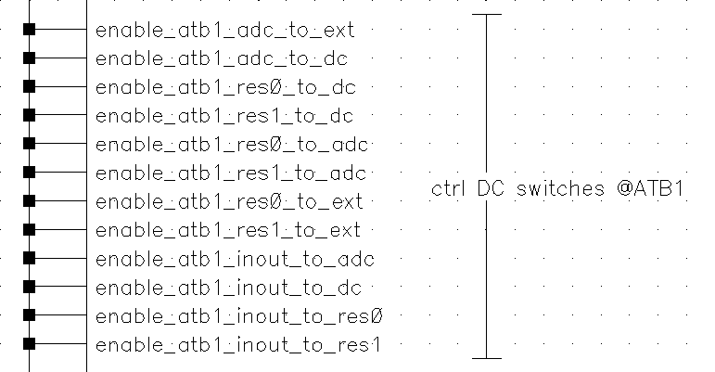
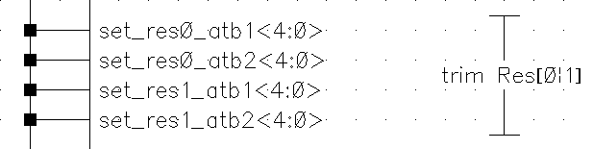
ida_mmw_rfe_atb_ana_lib/ida_mmw_rfe_atb_ana_dc_atb_model
Switch control versus
physical switch @connection
diagram
DC ATB switch controls
(top-level symbol ATB-RFE)

Slide 12
AC-ATB quick reference

Slide 13

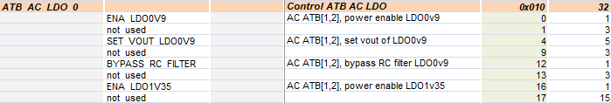
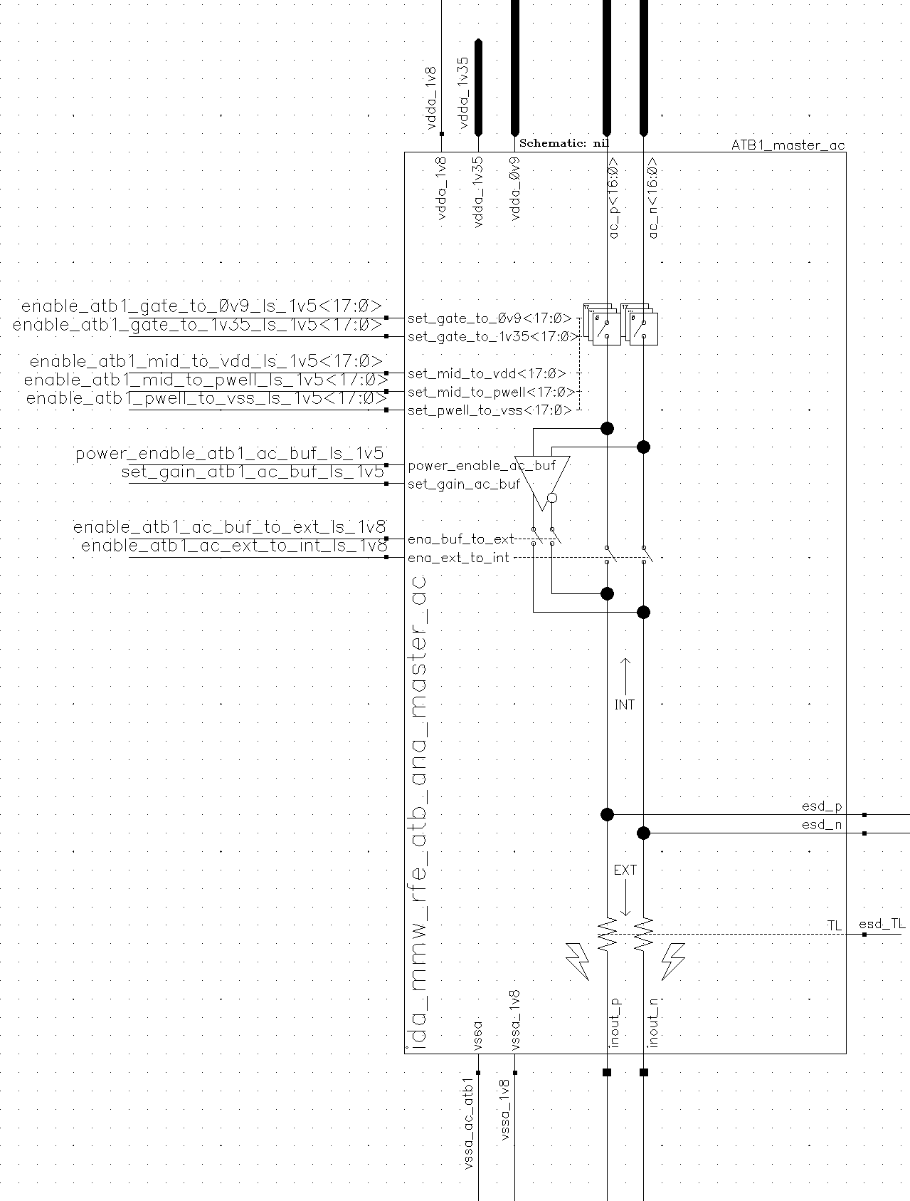
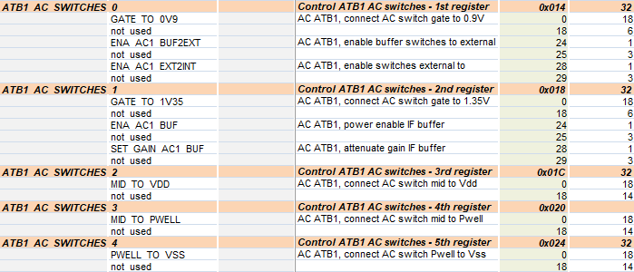

◆
program 1.35V LDO (BUT first program the LDO 0V9, see next slide)
AC ATB[1,2]
valid for
RX IP, ADC IP,
Vtune @APLL
IP
b’1
b’10000
17x
p,n pair
b’0
b’1
make sure (ac) atb lines are not grounded….
b’0
b’0
❖
enable channel to test: ac_[p,n]<16:0>
Signal:
from
external to
IP (=internal)
can also be atb2
b’0..0
b’0
b’1
b’1
! Bit x activates channel x
b’0
b’0
b’0
b’1
b’0
only 1 signal pair (p,n)
can occupy the bus
⬥
enable channel to test: ac_[p,n]<16:0>
Signal:
from
IP to
External
(buffered to
Drive external load)
can also be atb2
b’0..0
b’1
b’0
b’1
! Bit x activates channel x
only
1x p,n pair
b’1
b’1
b’0
external
b’1
b’0

Slide 14
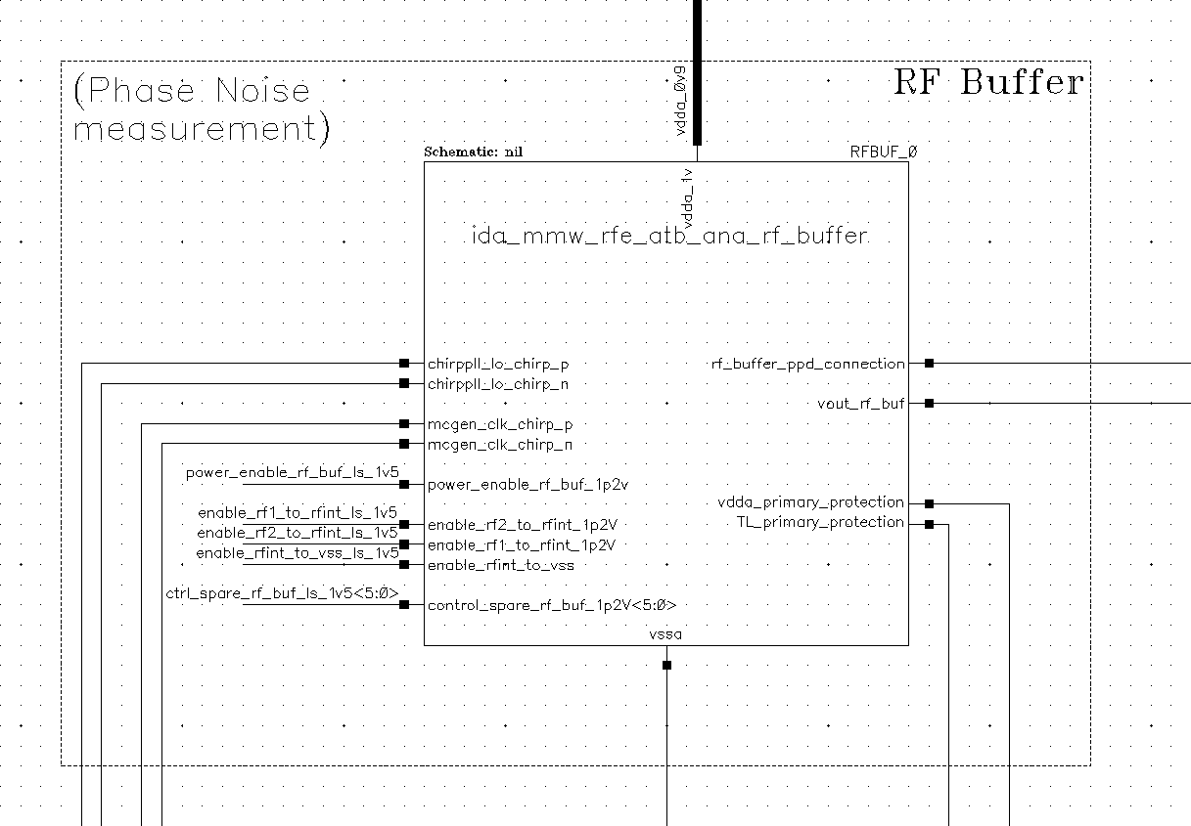
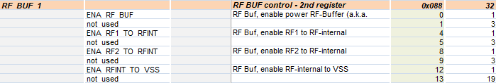
RF buffer
valid for
MCGEN
◆
program 0.9V LDO
b’1
b’10000
b’0
b’0
make sure (ac) atb lines are not grounded….
b’0
b’0
❖
Apply MCGEN signal
b’0
chirp pll
b’1
mcgen_p
OR
mcgen_n
mcgen p
b’0
mcgen n
b’0
b’0
chirp pll
b’0
mcgen p
b’1
mcgen n
b’0
only 1 signal is buffered, either p or n

Slide 15
Appendix

Slide 16

smartTRX/RFE/ATB
Tickets: artf813571 / artf825496 / artf825502
Michiel Hallie
CTO Design Centre
Mar/2021
Version 1.0

Slide 17
Introduction
Tickets being addressed
☑ RFE_DFT_ATB]Add extra switch control to vneg_se signal in BISTADC block (https://www.collabnet.nxp.com/sf/go/artf813571)
Details, see slide #3
☑ [ATB-RFE] possibility to cancel offset by swapping so-called p- and n-signal at DC-ATB (https://www.collabnet.nxp.com/sf/go/artf825496)
Details, see slide #4
☑ [ATB-RFE] possibility to measure the voltage over the 'I2V' resistor differentially (https://www.collabnet.nxp.com/sf/go/artf825502)
Details, see slide #5
Design implementation
See slides #6..11
Cells involved
ida_mmw_rfe_atb_ana_lib/ida_mmw_rfe_atb_ana_atb_dc_mux_31_nmos (slide #6, 1)
ida_mmw_rfe_atb_ana_lib/ida_mmw_rfe_atb_ana_dcsw_h_nmos3u_pulldown (slide #7)
ida_mmw_rfe_atb_ana_lib/ida_mmw_rfe_atb_ana_atb_dc_mux_31 (slide #6, 2)
ida_mmw_rfe_atb_ana_lib/ida_mmw_rfe_atb_ana_dcsw_t_cmos (slide #10)
ida_mmw_rfe_atb_ana_lib/ida_mmw_rfe_atb_ana_dcsw_t_nmos3u_pulldown (slide #10)
ida_mmw_rfe_atb_ana_lib/ida_mmw_rfe_atb_ana_go2_decoder_2b_unit (slide #7, #8)
Summary
It started with ticket artf813571, and from there it was not so much effort to implement also artf825496 and artf825502

Slide 18
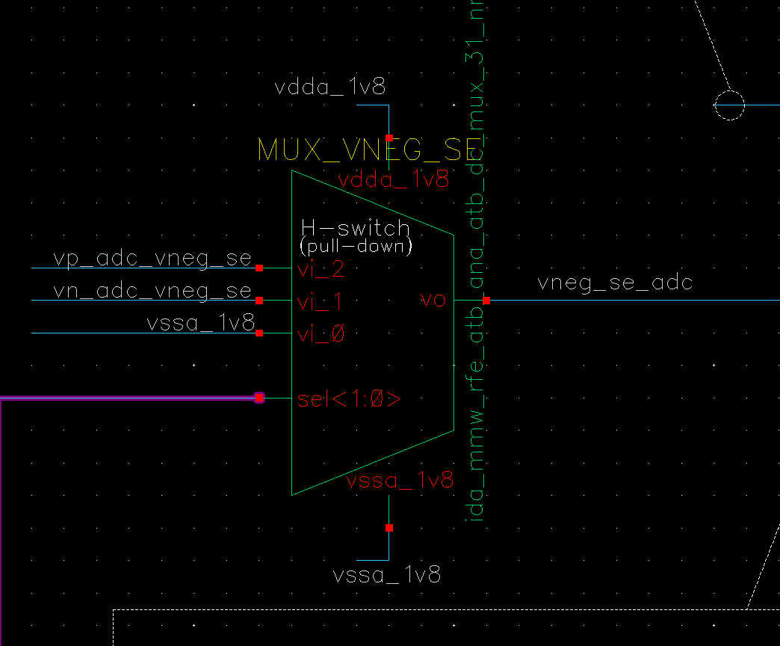
RFE_DFT_ATB]Add extra switch control to vneg_se signal in BISTADC block
(https://www.collabnet.nxp.com/sf/go/artf813571)
Description
In the current design, in order to minimize the impact of ground offset during the measurement, vneg_se signal has been connected to atb_n. However, lately we have discovered the limitation for this implementation. In single-ended mode, the difference between vneg_se and BISTADC ground shall be within [-20mV, 100mV]. This cannot be guaranteed by all IPs. In order to create the maximal flexibility, we would like to propose a switch matrix like in TX IP to control the connection of vneg_se in ATB IP as well. The basic idea is to enable vneg_se to have 3 connection possibilities: atb_n, atb_p and ground of BISTADC.
Design implementation
In Fig.3.1 a 3-input-MUX is introduced which makes it possible to connect the following nodes to vneg_se of the ADC:
❶ atb_p ↔ vp_adc_vneg_se
❷ atb_n ↔ vn_adc_vneg_se
❸ ground ↔ vssa_1v8
The H(alf) switches in the MUX are implemented as NMOSTs and the input is pulled to ground when not
Selected. This prevents possible floating inputs when not selected.
To get the bigger picture of the implementation, the MUX can also be found in the schematic @slide #6
MH@wk2126.3:
→ sel_MUX_VNEG_SE<1:0>=b’10
→ sel_MUX_VNEG_SE<1:0>=b’01
→ sel_MUX_VNEG_SE<1:0>=b’00
❶
❷
❸
Fig.3.1 3-input-MUX: 2

Slide 19
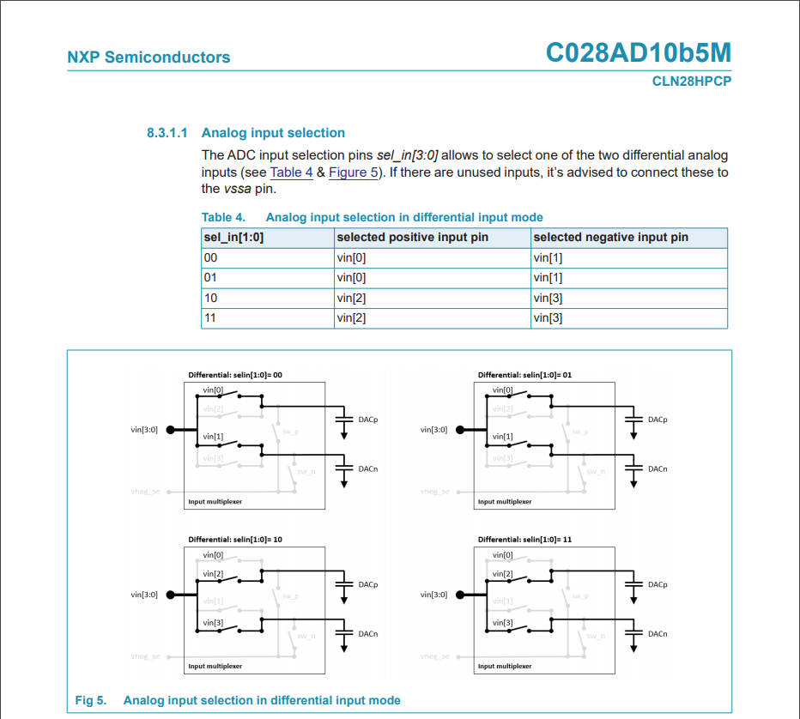
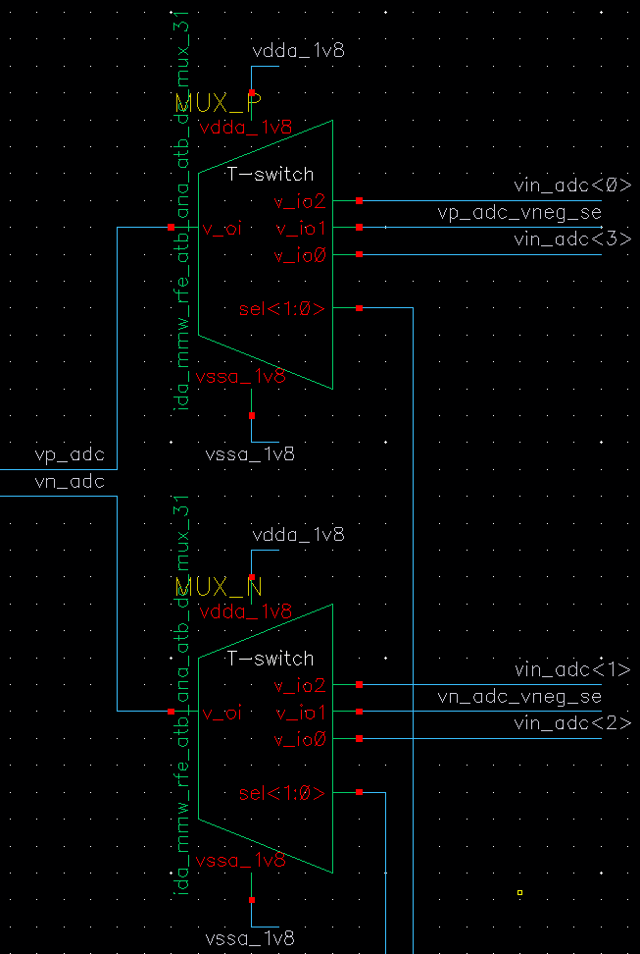
[ATB-RFE] possibility to cancel offset by swapping so-called p- and n-signal at DC-ATB (https://www.collabnet.nxp.com/sf/go/artf825496)
Description
Based on Design Review @Bronze the question was raised for having this option.
This option is often used when no calibration is in place. However, the ADC @ATB can be calibrated, and as such this option is considered as nice to have. Alternatively, having this option makes the application more robust.
Design implementation
In Fig.4.2 a 3-input-MUX is introduced which makes it possible to swap nodes vp_adc and vn_adc going to the ADC:
vp_adc ↔ pos. input vin_adc<0> ^{(*)}
OR neg. input vin_adc<3> ^{(*)}
vn_adc ↔ neg. input vin_adc<1> ^{(*)}
OR pos. input vin<adc<2> ^{(*)}
^{(*)} see Fig.4.1 for details
The T switches (see also slide #11) in the MUX are
implemented as NMOS or CMOS (NMOS||PMOS) and
the middle (T) node is pulled to ground@PMOST and
pulled to supply@NMOST.
The choice for pulling the T-node to ground or supply is
based on not having any logic within the cells (i.e. optimize layout)
To get the bigger picture of the implementation, the MUX
can also be found in the schematic @slide #6
MH@wk2126.3:
→ sel_MUX_P<1:0>=b’10
sel_MUX_P<1:0>=b’00
sel_MUX_N<1:0>=b’10
sel_MUX_N<1:0>=b’00
Fig.4.1 Source: DataSheet C028AD10b5M, Rev. 1.2 — 5 February 2020
link: amos_c028hpcp_ad10b5m_data_sheet.pdf
Fig.4.2 3-input-MUX: 2

Slide 20
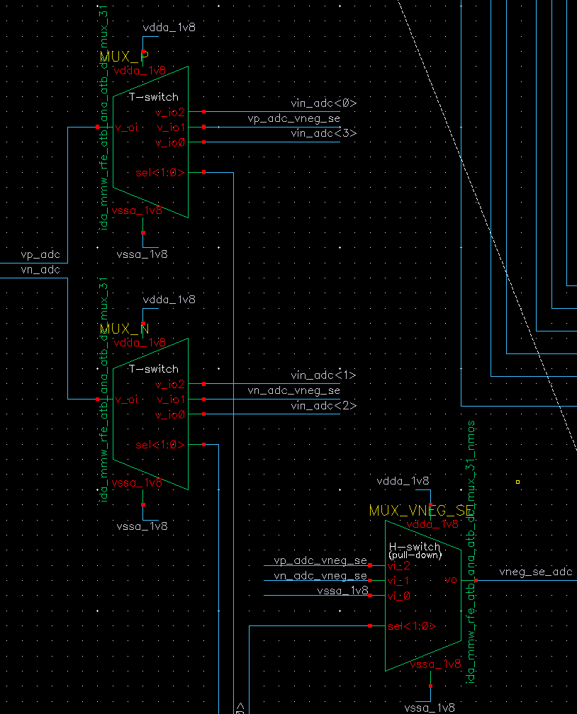
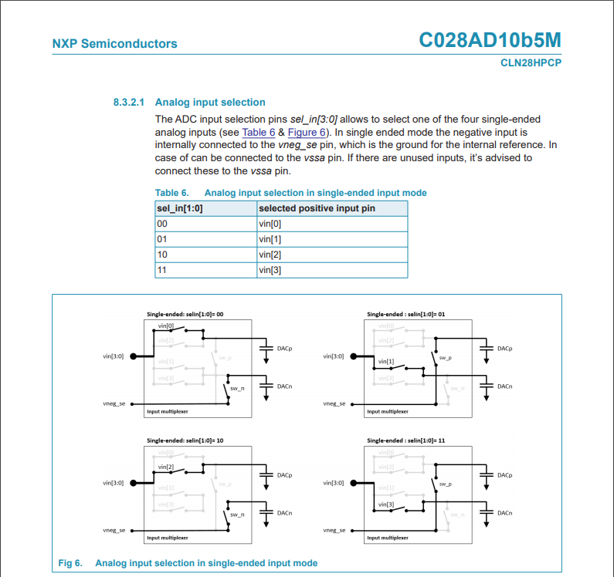
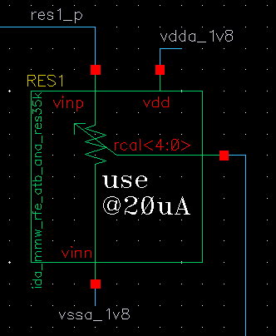
[ATB-RFE] possibility to measure the voltage over the 'I2V' resistor differentially (https://www.collabnet.nxp.com/sf/go/artf825502)
Description
Based on the Design Review @Bronze, the option of measuring differentially instead of Single Ended (SE) came in view.
Currently the 'I2V' resistors, used for converting a current into voltage, can only be used for Single Ended (SE) measuring.
However, the concern is that the accuracy of the measurement might be affected by local ground bounce. As such, the option of being able to measure differentially is requested.
The DC-ATB path in combination with measuring via the ADC @ATB is part of the so-called Functional Safety.
Design implementation
In Fig.5.3 a 3-input-MUX is introduced which makes it possible to connect the following nodes to vneg_se of the ADC:
❶ atb_p ↔ vp_adc_vneg_se
❷ atb_n ↔ vn_adc_vneg_se
❸ ground ↔ vssa_1v8
The voltage over the ‘I2V’ resistor (SE mode) is
measured via e.g., ‘res1_p’ (see Fig.5.1) and node vssa_1v8.
Where, node res1_p is conveyed to the ADC via the ATB
connection and its reference (vssa_1v8) is conveyed via
MUX_VNEG_SE (see Fig.5.3)
Fig.5.2 depicts the SE configuration for the ADC
MH@wk2126.3:
→ sel_MUX_VNEG_SE<1:0>=b’10
→ sel_MUX_VNEG_SE<1:0>=b’01
→ sel_MUX_VNEG_SE<1:0>=b’00
Fig.5.2 Source: DataSheet C028AD10b5M, Rev. 1.2 — 5 February 2020
link: amos_c028hpcp_ad10b5m_data_sheet.pdf
Fig.5.1 trimmable resistor
Fig.5.3 3-input-MUX: 2

Slide 21
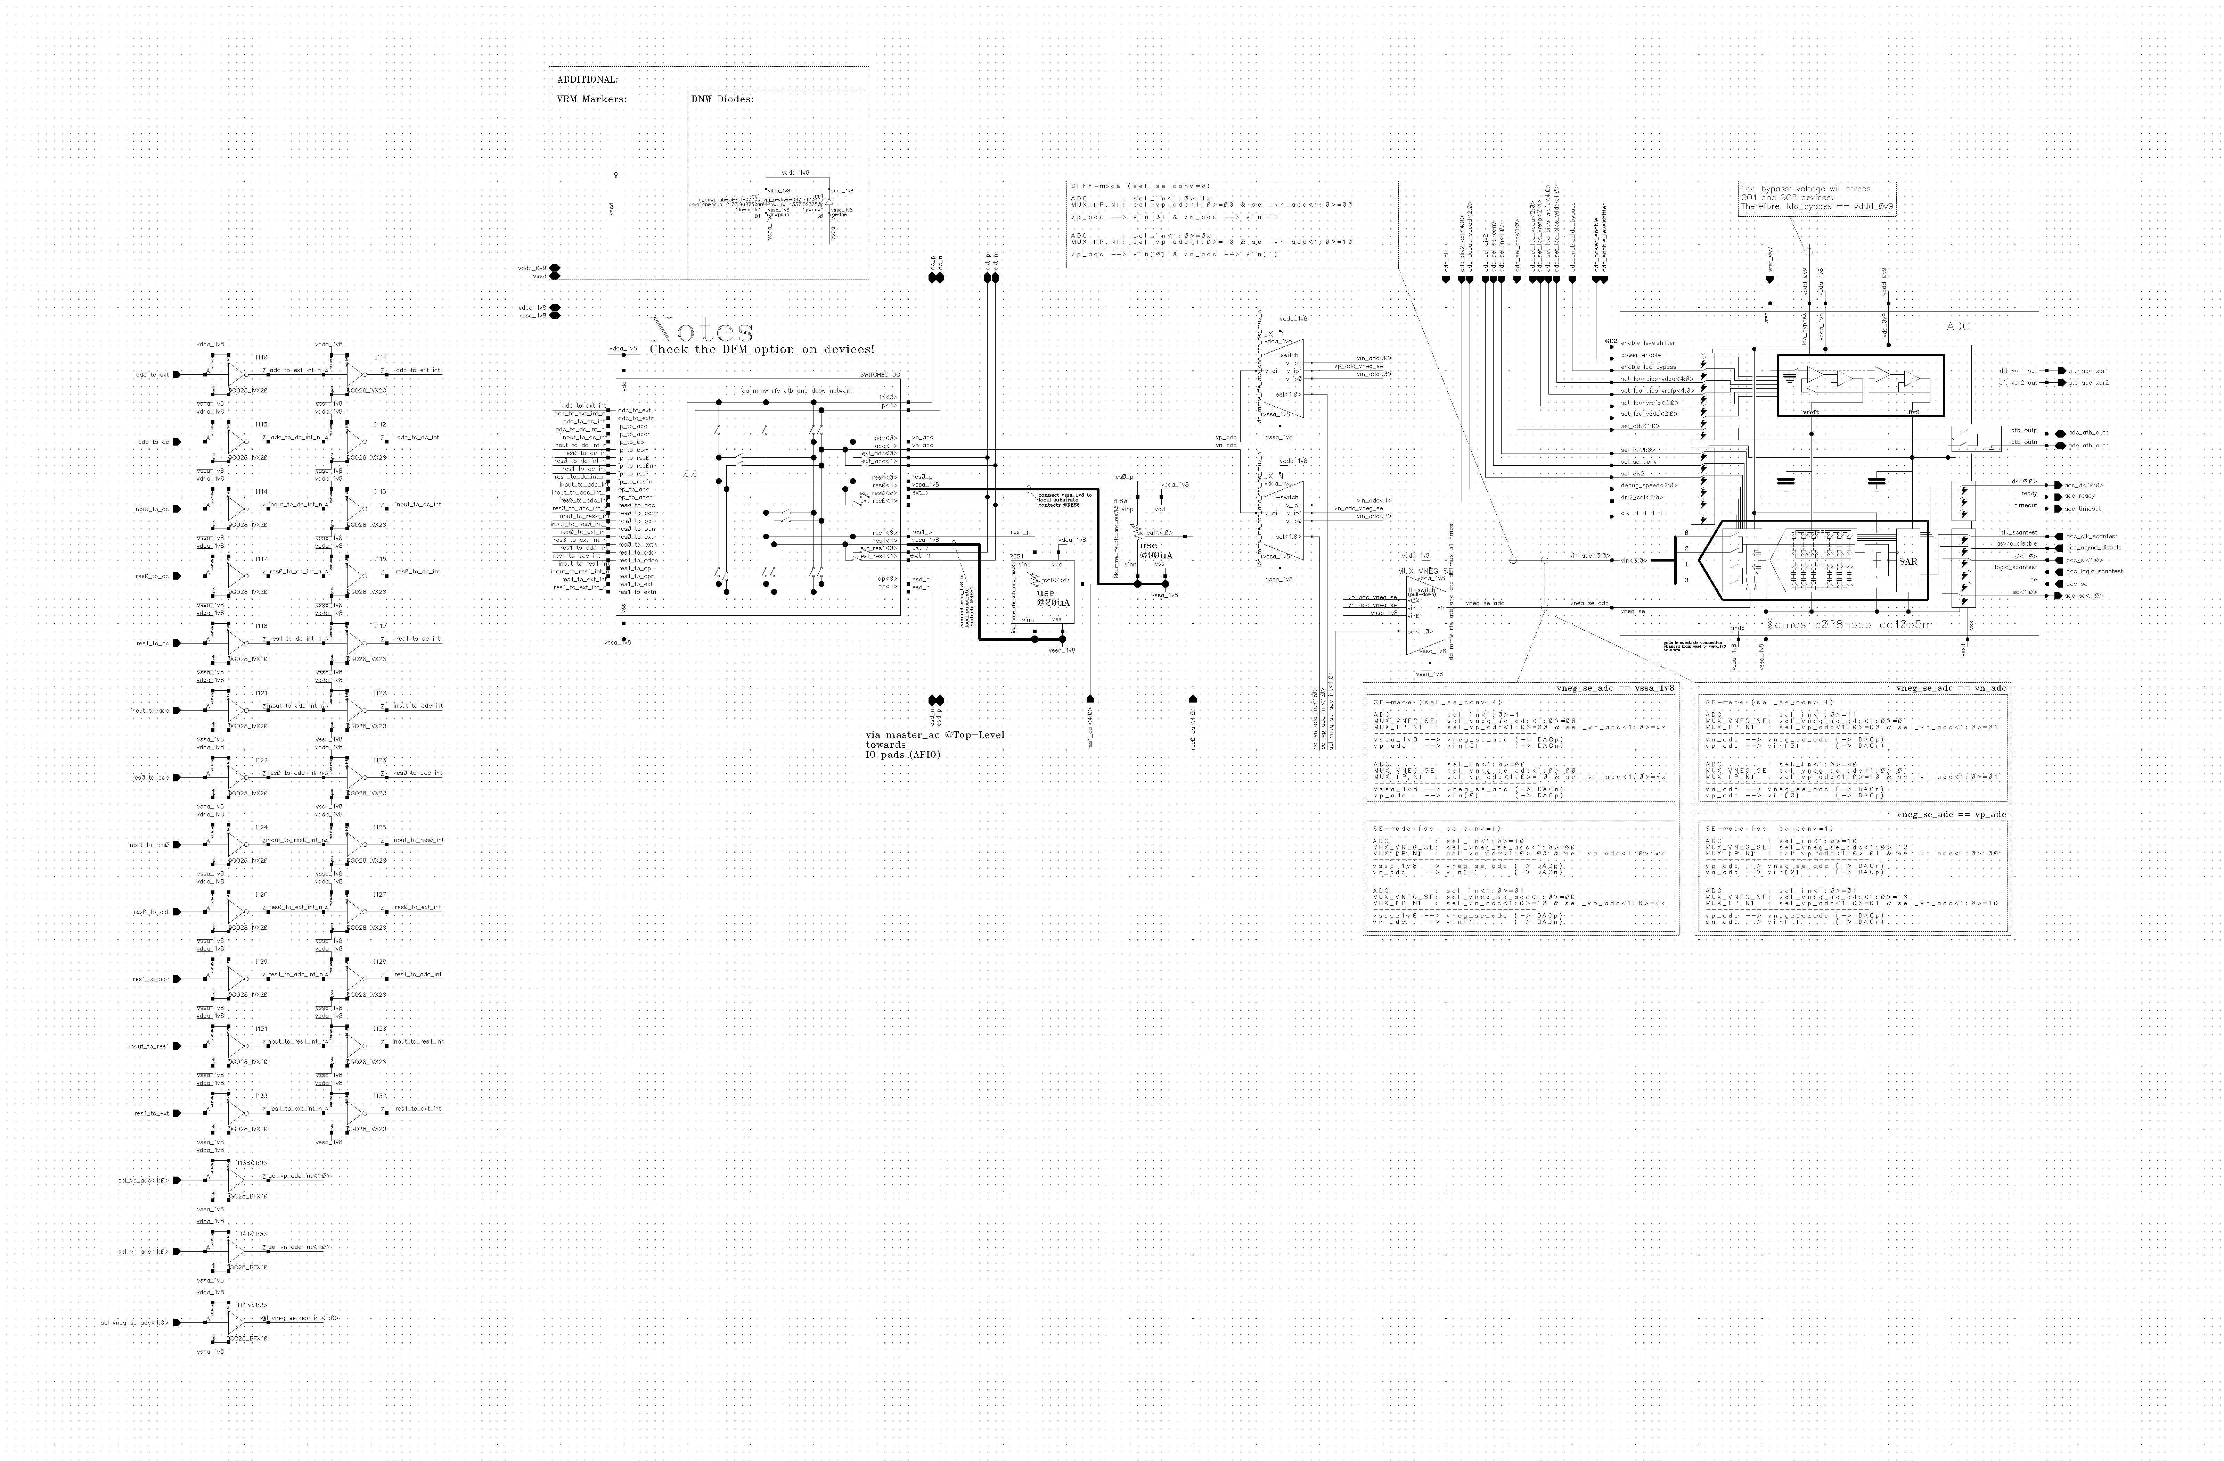
ida_mmw_rfe_atb_ana_lib/ida_mmw_rfe_atb_ana_master - schematic
2
2
1
nodes grounded @vssa_1v8 when
not used
MH@wk2127.1: updated table

Slide 22
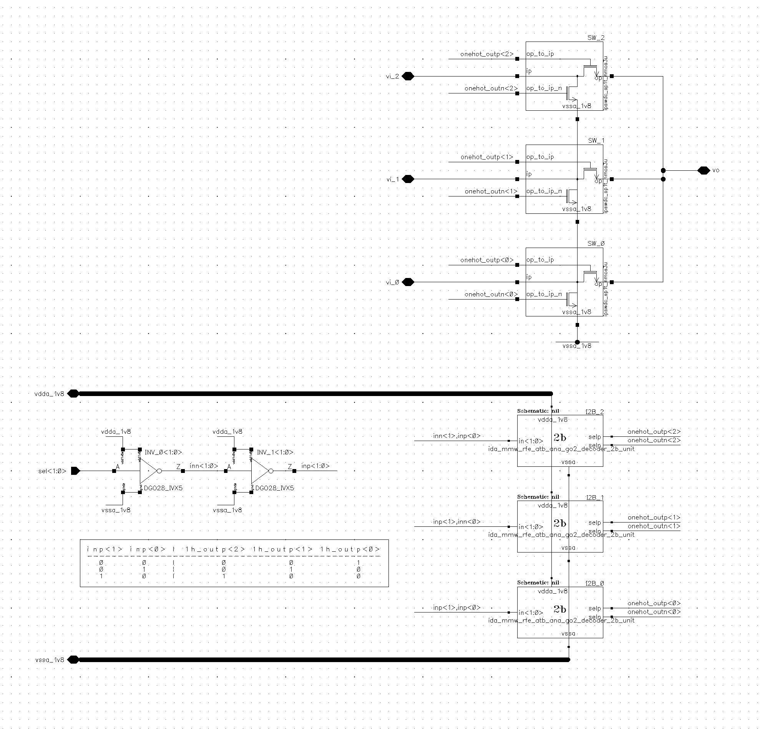
1: MUX – H-switch 1#3
H(alf) switch
input @gnd when not selected
Rationale: no floating nodes between the 2 MUXes
(see also slide #6)
NMOS
NMOS
NMOS
nodes grounded @vssa_1v8 when
switch is disabled

Slide 23
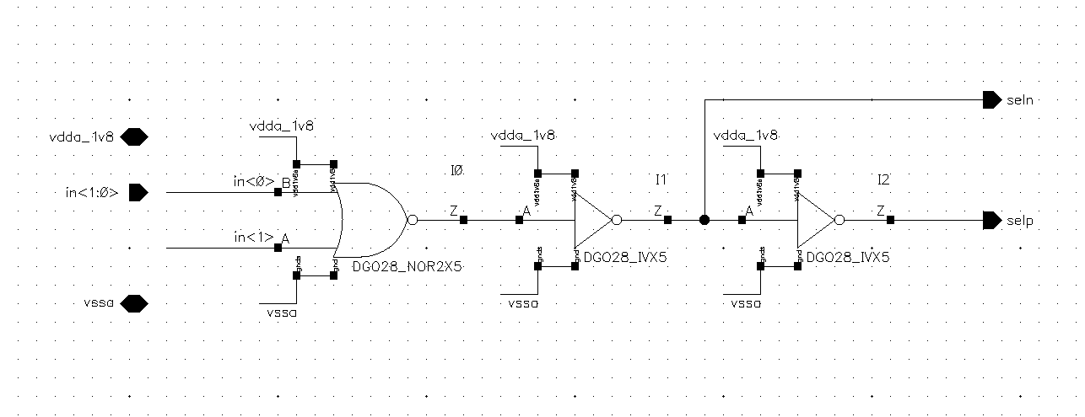
1: MUX – H-switch 2#3
one-hot

Slide 24
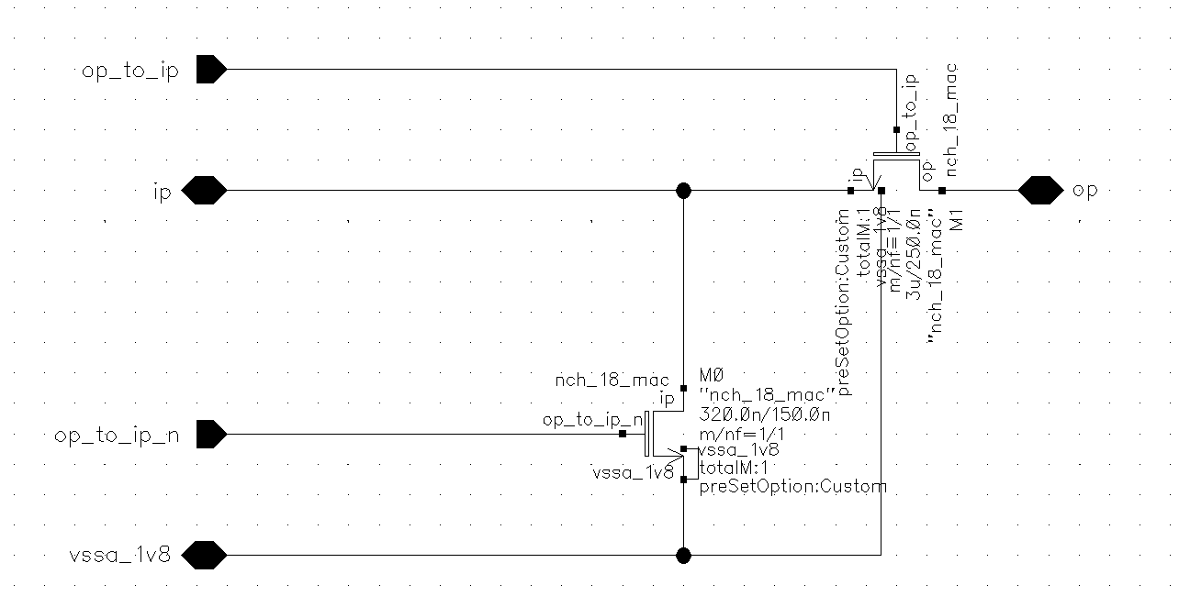
1: MUX – H-switch 3#3

Slide 25
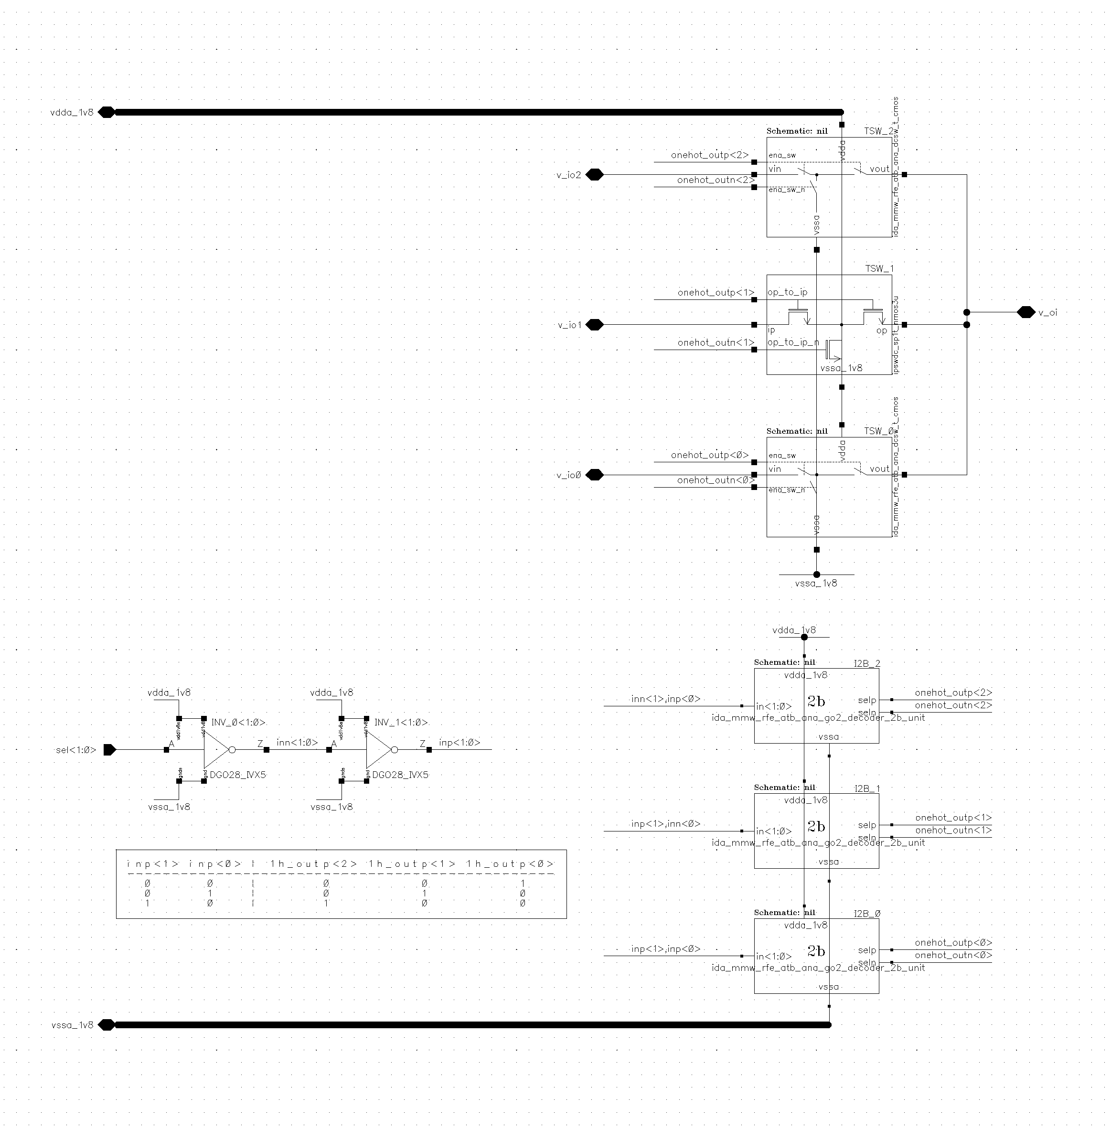
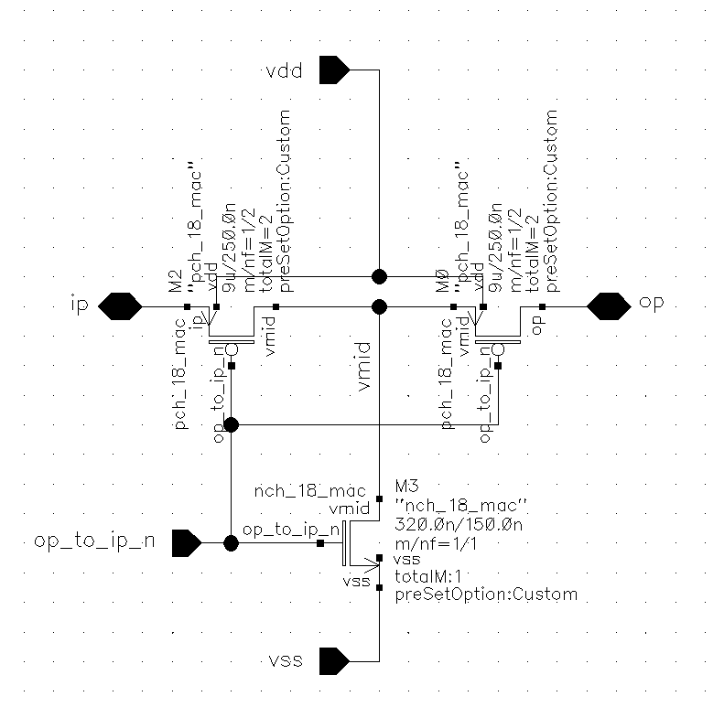
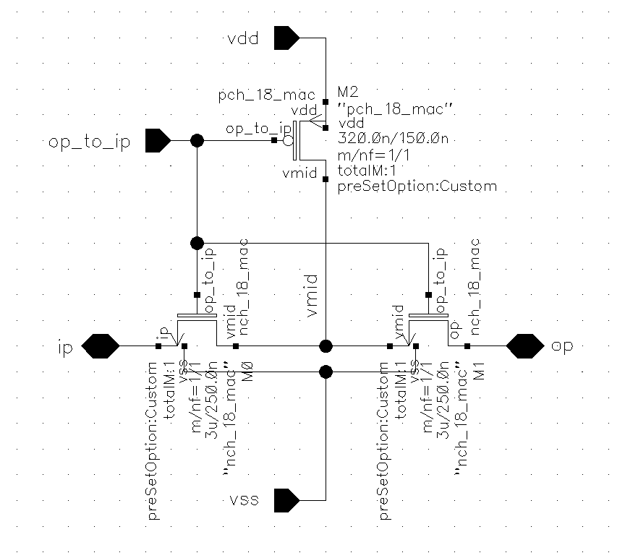
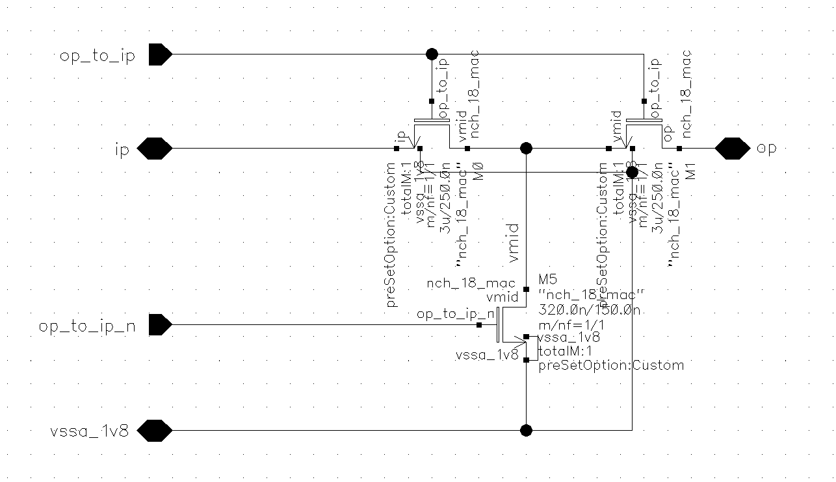
2: MUX – T-switch 1#2
PMOS
CMOS
NMOS
pull to gnd
one-hot
NMOS
CMOS
pull to supply
NMOS
pull to gnd

Slide 26
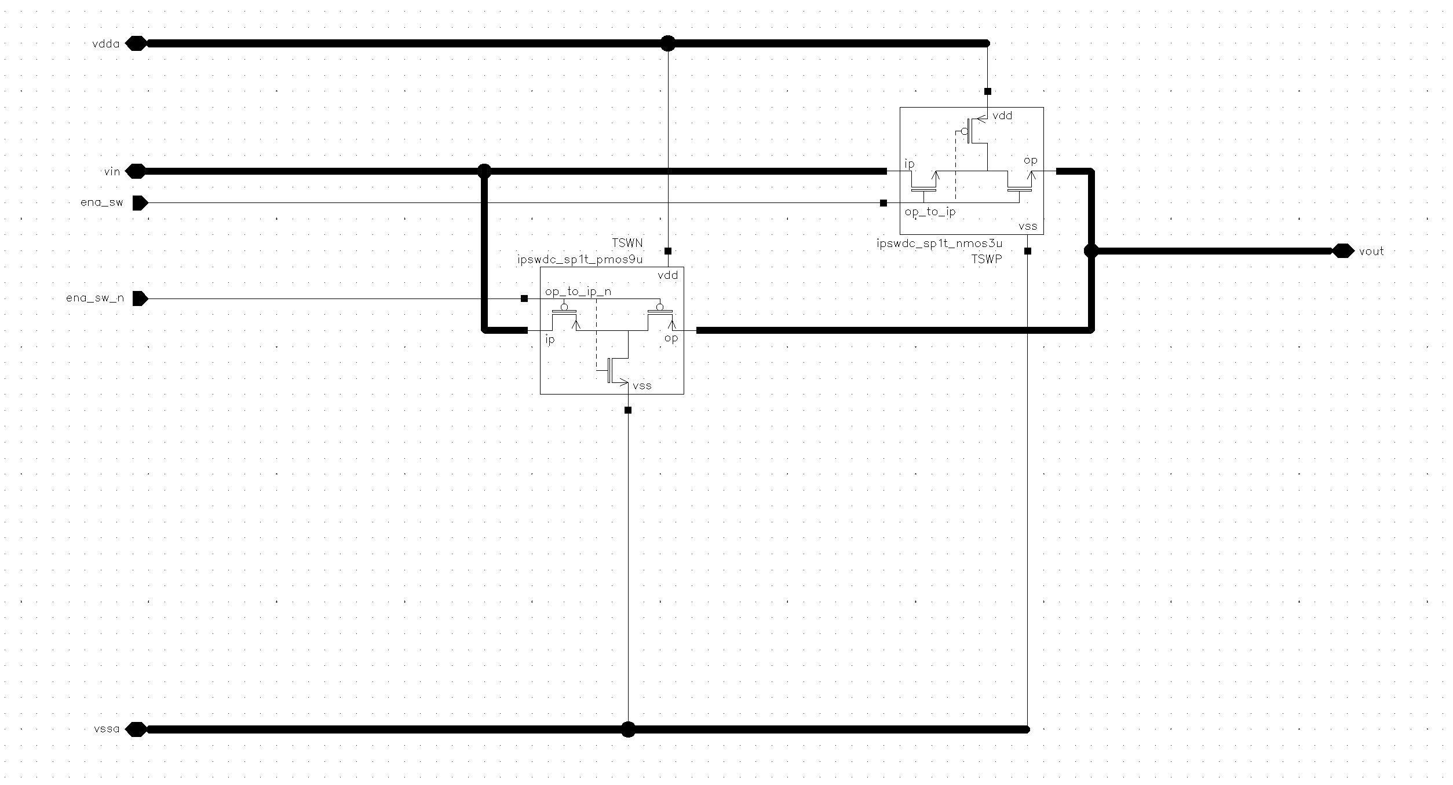
2: MUX – T-switch 2#2
T-switch nmos (pull down)
T

Slide 27
--/ END /--

